Slide 1

Benchmarking multi-modal LLMs against specialist AI models on computer vision tasks
Guide
Prof. Dr. René Peinl
Presented by
Ruturaj Jayant Kotwal

Slide 2
Introduction
Multi-Modal Large Language Models (MLLMs) are models designed to process and understand multiple types of data (e.g., text, images, audio).
Gemini | Google | Dec 2023
MiniGPT-v2 | Meta | Oct 2023
GPT-4 | OpenAI | Mar 2023
Specialist AI models are tailored specifically for individual tasks in computer vision. They are optimized for high performance in their specific domain.
RS3Mamba | Apr 2024 | Sematic Segmentation
YOLO-NAS | May 2023 | Object Detection
BLIP | Feb 2022 | Image Classification

Slide 3
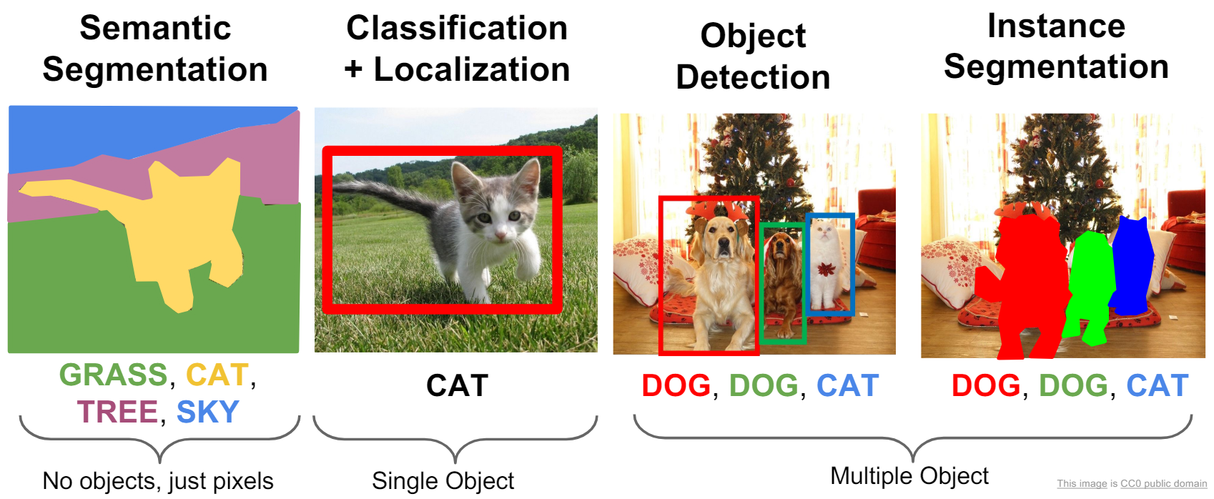
Computer Vision tasks
https://cs231n.stanford.edu/slides/2017/cs231n_2017_lecture11.pdf

Slide 4
Importance of Benchmarking
Fair comparisons
Everyone uses the same "yardstick" (datasets & metrics) to measure performance.
Strengths & Weaknesses
Benchmarks expose what a model does well and where it falls short.
Real-World Ready
They ensure models work not just in a lab, but also in messy, real-world conditions.
Faster Progress
Public benchmarks let researchers compare, collaborate, and push the boundaries of Computer Vision.

Slide 5
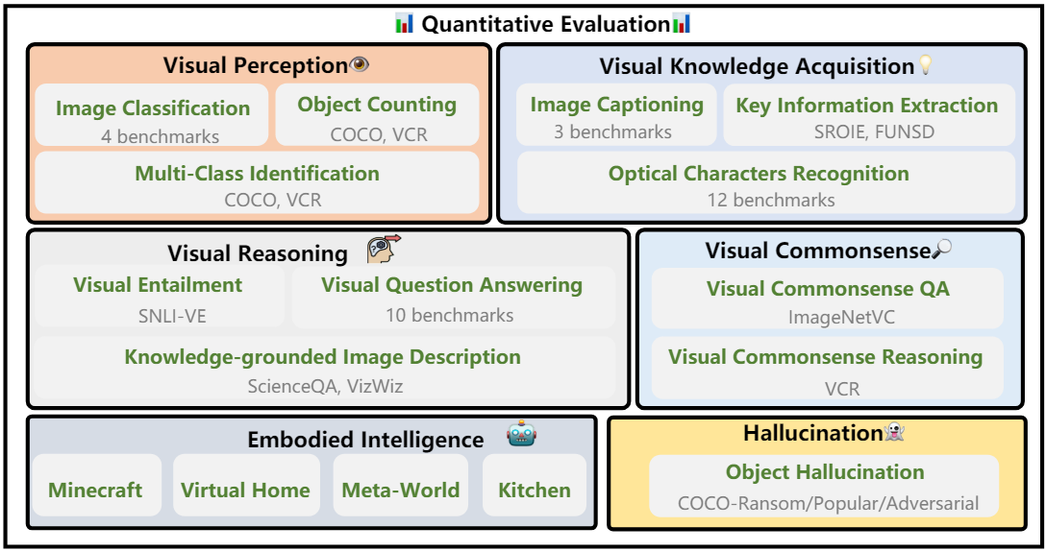
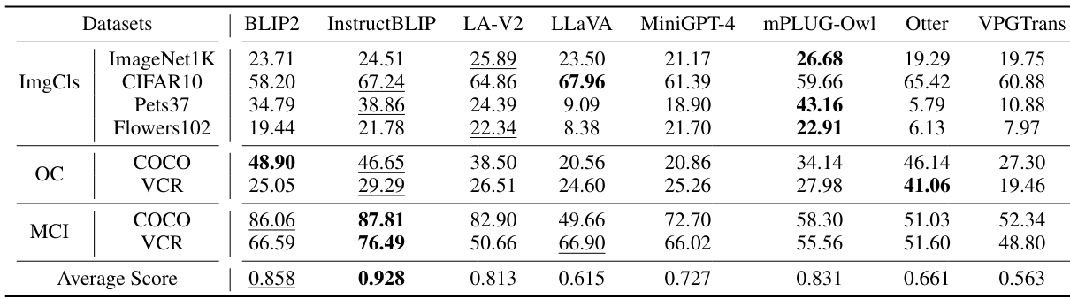
LVLM-eHub
Instruction-tuned LVLM with massive in-domain data such as InstructBLIP heavily overfits many existing tasks, generalizing poorly in the open-world scenario.
Instruction-tuned LVLM with moderate instruction-following data may result in object hallucination issues.
Employing a multi-turn reasoning evaluation framework can mitigate the issue of object hallucination.
Visual
Perception
Tasks
https://arxiv.org/pdf/2306.09265

Slide 6
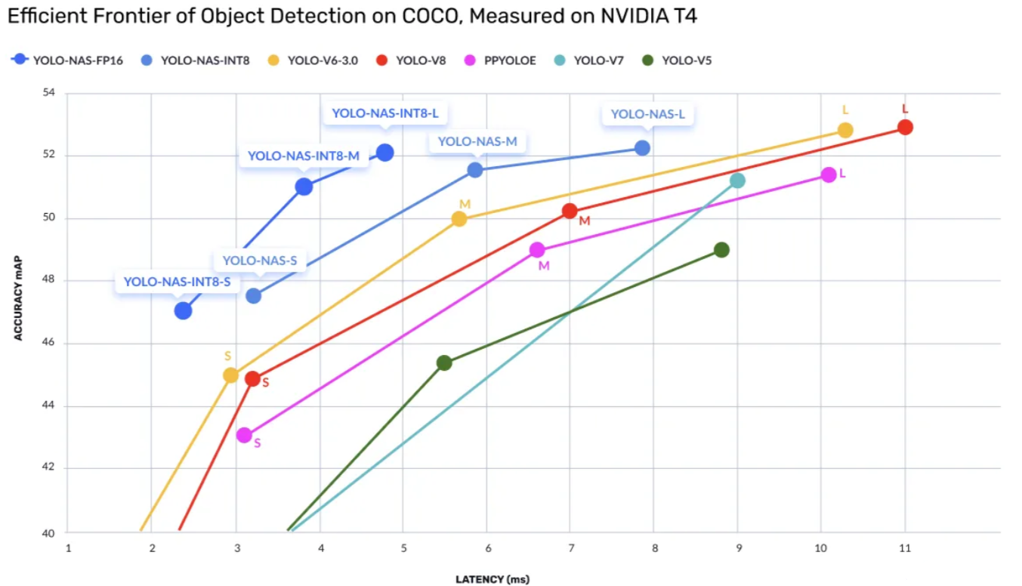
YOLO models (2023)
Accuracy (mAP)
YOLO NAS: mAP @0.5 = 75.6%, mAP @0.5:0.95 = 49.3%
YOLOv8: mAP @0.5 = 76.8%, mAP @0.5:0.95 = 51.2%
Speed (FPS)
YOLO NAS: FPS (1080p Image) = 150
YOLOv8: FPS (1080p Image) = 140
Model Size
YOLO NAS: Parameters = 90M, Size on Disk = 250MB
YOLOv8: Parameters = 88M, Size on Disk = 260MB
https://medium.com/@pankajsharma01/analyzing-the-performance-yolo-nas-and-yolo-v8-side-by-side-11406800906a

Slide 7
Benchmark Plan
Selected Tasks:
Image Classification
Object Detection
Image Captioning
Selected Models:
microsoft/Phi-3-vision-128k-instruct
openbmb/MiniCPM-Llama3-V-2_5
MILVLG/Imp-v1.5-3B-Phi2
microsoft/kosmos-2-patch14-224
Benchmark Datasets (20-30 samples each):
Image Classification:
CIFAR-10
ImageNet
Object Detection:
COCO
PASCAL VOC
Image Captioning:
MS COCO
Flickr30k
Evaluation Metrics:
Image Classification: Accuracy, Precision, Recall, F1-Score
Object Detection: Mean Average Precision (mAP), Precision, Recall
Image Captioning: BLEU, METEOR, CIDEr
Compare the results of multimodal LLMs with specialist models using the same metrics.

Slide 8
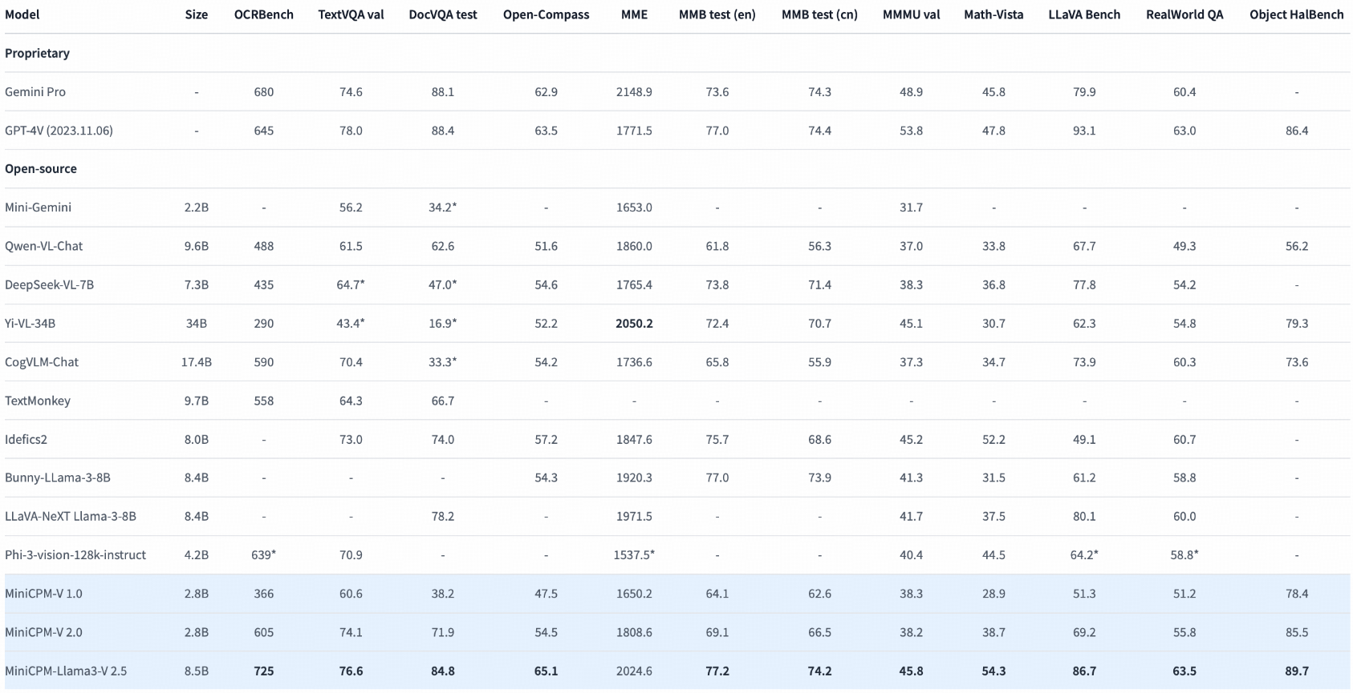
MiniCPM-Llama3-V-2_5
OCR capability and supports 30+ languages
Built on SigLip-400M and Llama3-8B-Instruct
https://huggingface.co/openbmb/MiniCPM-Llama3-V-2_5

Slide 9
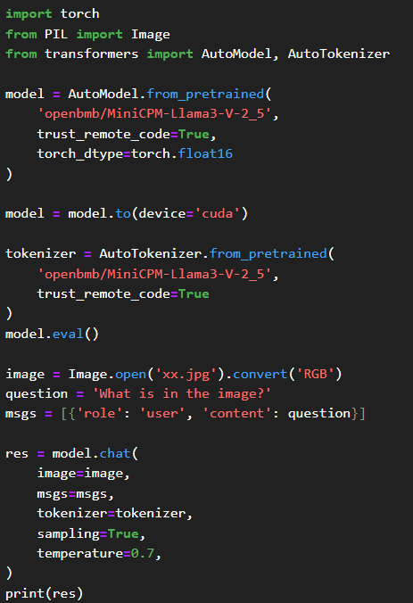

What is in the image?
OUTPUT : The image features a woman sitting on a wooden chair in an open field. She's holding a camera and appears to be taking a photograph. In front of her, there is a table covered with a white cloth. On the table, there are some objects including what looks like a bottle and a plate with food items. The background shows a vast field with a few distant structures, possibly electricity towers.
https://images.pexels.com/photos/23947602/pexels-photo-23947602/free-photo-of-a-woman-sitting-in-a-field-with-a-camera.jpeg?auto=compress&cs=tinysrgb&w=600&lazy=load

Slide 10
Literature Review
Benchmark Name | Date | Description
LVLM-eHub | June 2023 | A comprehensive benchmark for evaluating large vision-language models (LVLMs) through both quantitative performance and human feedback. The quantitative evaluation covers 16 tasks using over 40 text-related visual datasets to assess six key capabilities of LVLMs.
LAMM | June 2023 | An open-source project for MLLMs. It includes a dataset and benchmark for image and point-cloud instruction tuning, aiming to create a comprehensive ecosystem for MLLM training and evaluation. The research demonstrates MLLMs' effectiveness with visual data and their potential for generalization.
MESS | Dec 2023 | Benchmark for Multi-domain Evaluation of Semantic Segmentation, enabling comprehensive performance analysis across diverse domain-specific datasets such as medicine, engineering, and agriculture. By reviewing 120 datasets and selecting a representative subset of 22 datasets, MESS facilitates the evaluation of zero-shot transfer models. Eight recent models are evaluated on this benchmark.
YOLOWeeds | Jan 2023 | This study introduces the CottoWeedDet12 dataset, comprising 5648 images of 12 weed classes in cotton fields, and benchmarks 25 YOLO models. Detection accuracy ranges from 88.14% to 95.22% (mAP@0.5) and 68.18% to 89.72% (mAP@[0.5:0.95]). The dataset and software are publicly available to support future AI-powered weed detection research.

Slide 11
Paper | Date | Description
FACET: Fairness in Computer Vision Evaluation Benchmark | Aug 2023 | A large benchmark dataset with 32,000 images for image classification, object detection, and segmentation. Expert reviewers manually annotated person-related attributes (such as skin tone and hair type) and labelled fine-grained classes (e.g., disk jockey, guitarist). Results indicate that models show performance differences across demographic groups and intersections of attributes, highlighting fairness issues.
Battle of the Backbones (BoB) | Oct 2023 | BoB evaluates pretrained models, including vision-language and self-supervised learning, across diverse computer vision tasks, analyzing over 1500 training runs. While supervised CNNs excel, self-supervised learning shows promise, suggesting future SSL research focus on advanced architectures and larger datasets.
Benchmarking Object Detectors with COCO | March 2024 | COCO-ReM is introduced, a benchmark with high-quality mask annotations obtained through a semi-automatic pipeline. Comparing mask AP trends between COCO-ReM and COCO-2017 reveals changes in model rankings, emphasizing the importance of mask quality in advancing object detectors. The authors believe COCO-ReM will support future object detection research.
BenchLMM | Dec 2023 | A benchmark assessing Large Multimodal Models (LMMs) against various styles. Findings show LMMs suffer performance decline with different styles, even if excelling in one. Prompting LMMs to predict style before content enhances their reasoning. Intelligent LMMs should interpret errors from stylistic variations.

Slide 12
References
LVLM-eHub: A Comprehensive Evaluation Benchmark for Large Vision-Language Models (https://arxiv.org/abs/2306.09265)
LAMM: Language-Assisted Multi-Modal Instruction-Tuning Dataset, Framework, and Benchmark (https://arxiv.org/abs/2306.06687)
What a MESS: Multi-Domain Evaluation of Zero-Shot Semantic Segmentation (https://arxiv.org/abs/2306.15521)
Performance Evaluation of Semi-supervised Learning Frameworks for Multi-Class Weed Detection (https://arxiv.org/html/2403.03390v1)
FACET: Fairness in Computer Vision Evaluation Benchmark (https://arxiv.org/abs/2309.00035)
Battle of the Backbones: A Large-Scale Comparison of Pretrained Models across Computer Vision Tasks (https://arxiv.org/pdf/2310.19909)
Benchmarking Object Detectors with COCO: A New Path Forward (https://arxiv.org/abs/2403.18819)
BenchLMM: Benchmarking Cross-style Visual Capability of Large Multimodal Models (https://arxiv.org/abs/2312.02896)

Slide 13


